Slide 1

Development Iteration Demonstrations
Presentation 1
BY: PROJECT TEAM 02
HELISHA GUNVANTRAI PATEL (30391432)
JAHANVI PRAKASHKUMAR DARJI (30391512)
NADUN (30383224)
SANDEEP KAUR (30383224)
RIDHI (30362064)
Notes:
<a href='https://www.freepik.com/vectors/check'>Check vector created by stories - www.freepik.com</a>

Slide 2
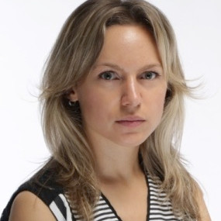
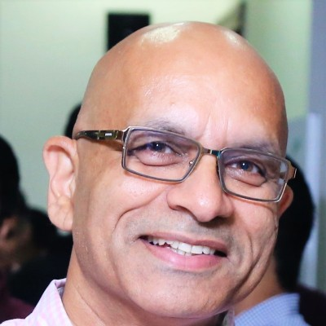
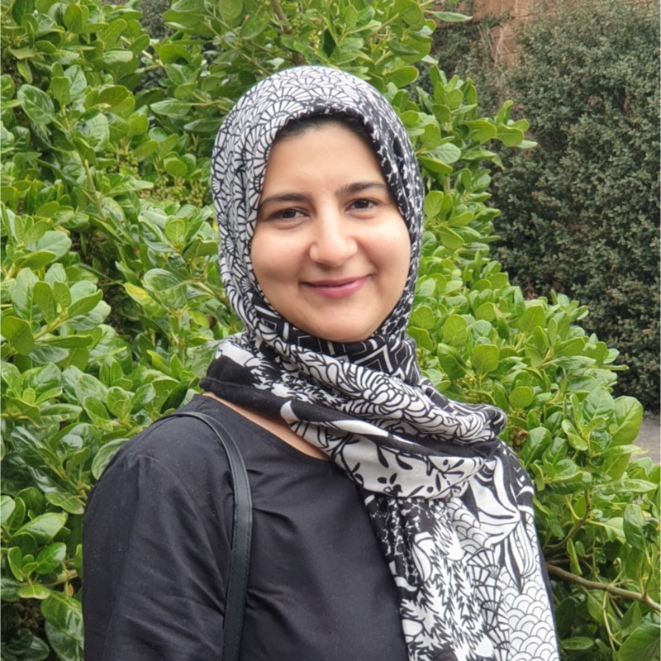
Team Organization:
Client Details
Marketa Mojzisova
Tabinda Khan
Anirudh Phadke
Employer Engagement Coordinator
E/L Programme Manager
Head of Digital Content
Notes:
Illustration : <a href="https://storyset.com/people">People illustrations by Storyset</a>
Photo : Photo by Albert Dera on Unsplash

Slide 3
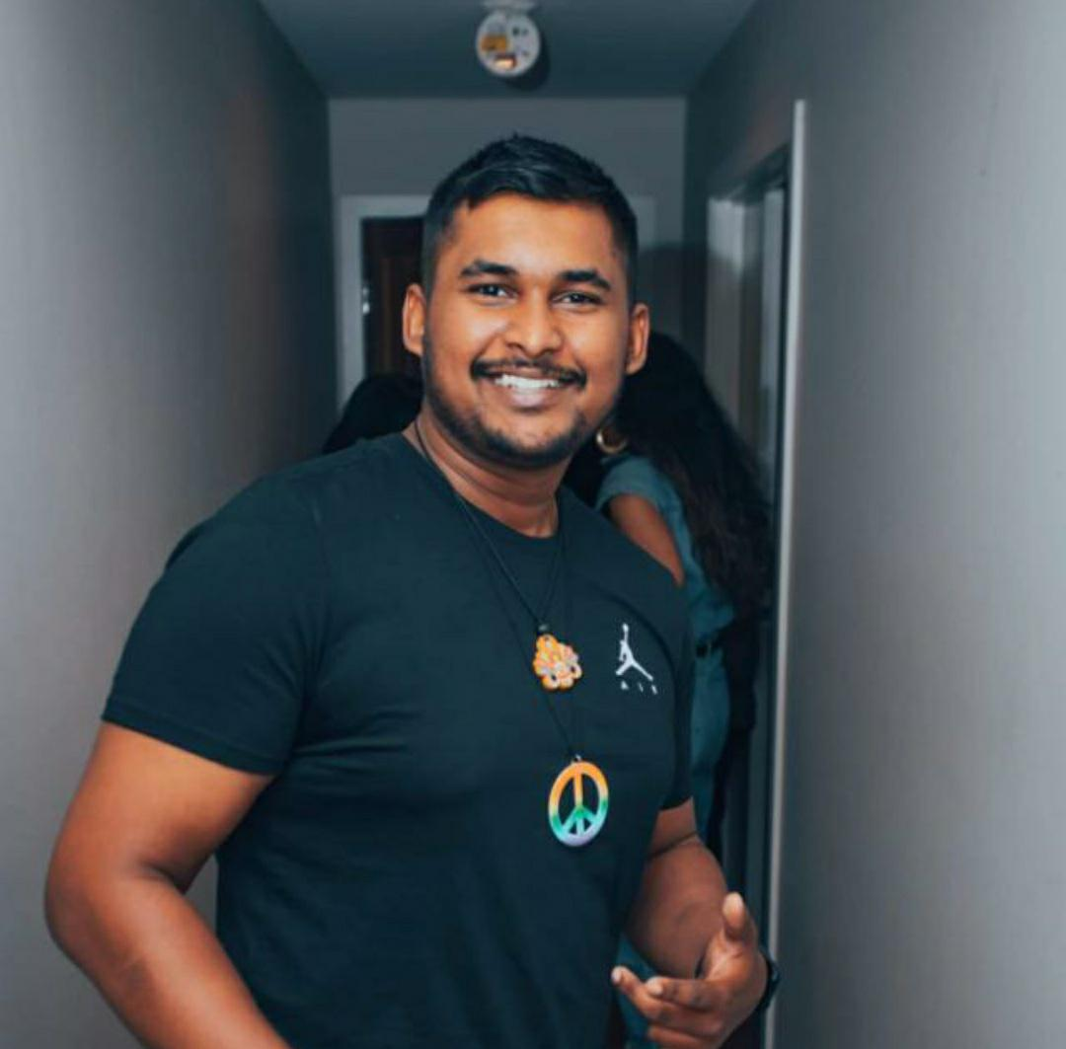

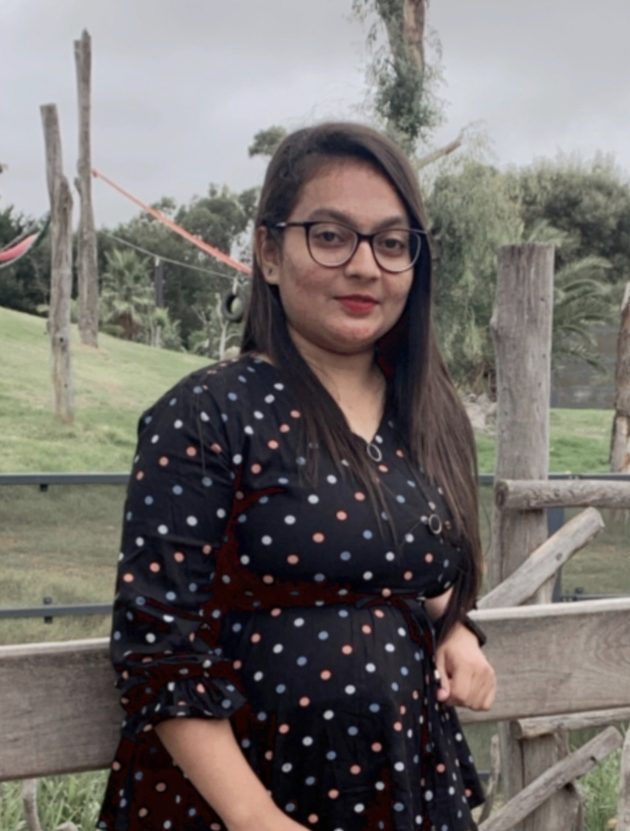
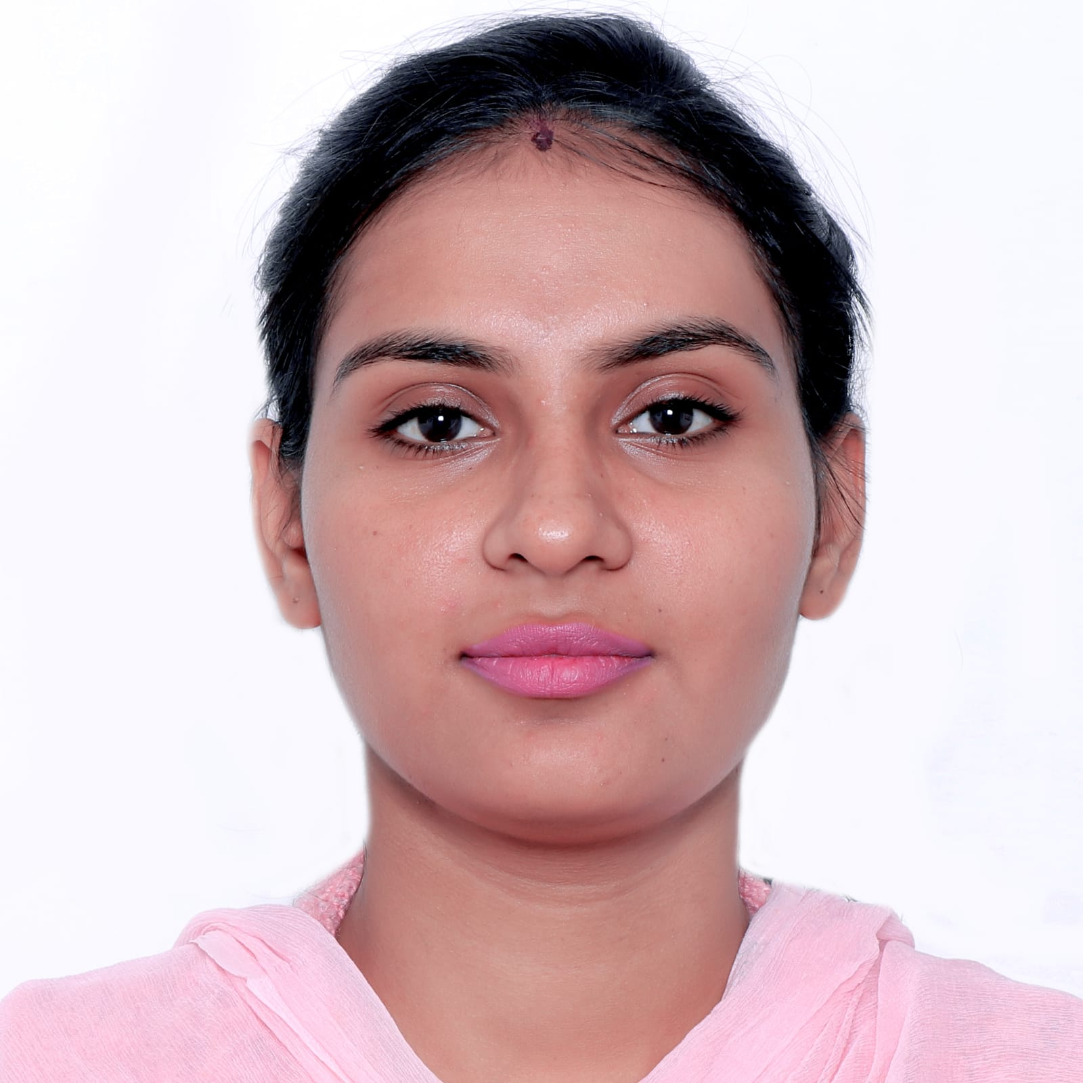
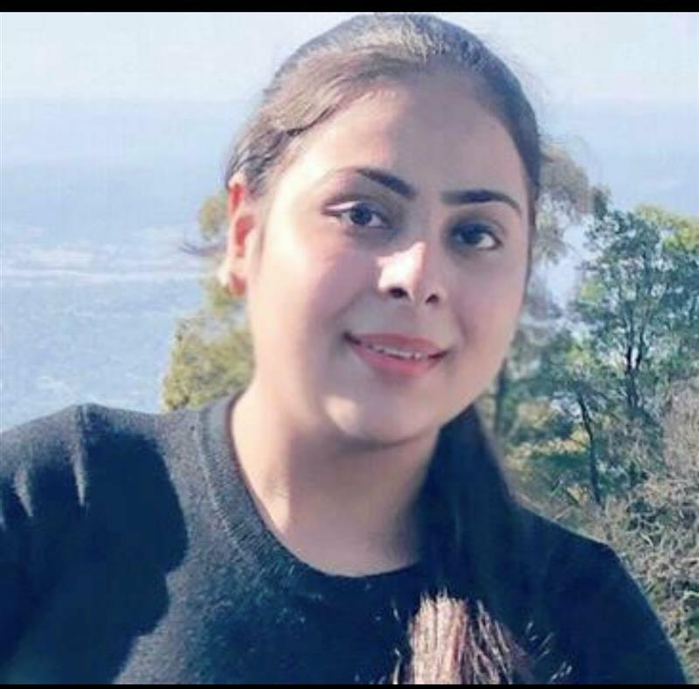
Team Members
PRODUCT OWNER
SCRUM MASTER
DESIGNER
DEVELOPER
TESTER
Nadun
Helisha
Jahanvi
Sandeep
Riddhi
Notes:
Illustration : <a href="https://storyset.com/people">People illustrations by Storyset</a>
Photo : Photo by Albert Dera on Unsplash

Slide 4
Roles and Responsibilities:
PRODUCT OWNER
NADUN
To manage and prioritize the product backlog.
To serve as a liaison between the product, and its development.
To motivate the team members, and be accessible to them.
SCRUM MASTER
HELISHA
To plan, and organize stand-up group meetings, on daily basis.
To assist the product owner with the product backlog.
To ensure good interaction between the development team and the product owner.
Notes:
Illustration : <a href="https://storyset.com/work">Work illustrations by Storyset</a>

Slide 5

DESIGNER
JAHANVI
Responsible for the performance of the project.
To provide all the intermediate results of the project work at the end of each sprint, to the scrum master.
DEVELOPER
SANDEEP
To develop project, as per the design approved by the client.
To participate in the daily scrum and other essential group meetings organized by the scrum master.
TESTER
RIDHI
To test whether the developed modules are working seamlessly or not.
To give an estimated amount of time required for delivering the tasks, assigned while developing the project.
Notes:
Illustration : <a href="https://storyset.com/work">Work illustrations by Storyset</a>

Slide 6
Overview & Description of Project:
Domain Specific:
The aim is to identify the improvement areas of current website by examining all the attributes.
Furnishing the clients with relevant recommendations to enhance the student engagement.
Technical Aspects:
To develop, test, and evaluate all the functionalities of the website
To hand over a well-tested Moodle to the client.
To design an interactive element for Moodle, by using H5P and relevant technologies.
Notes:
<a href='https://www.freepik.com/vectors/event'>Event vector created by stories - www.freepik.com</a>

Slide 7
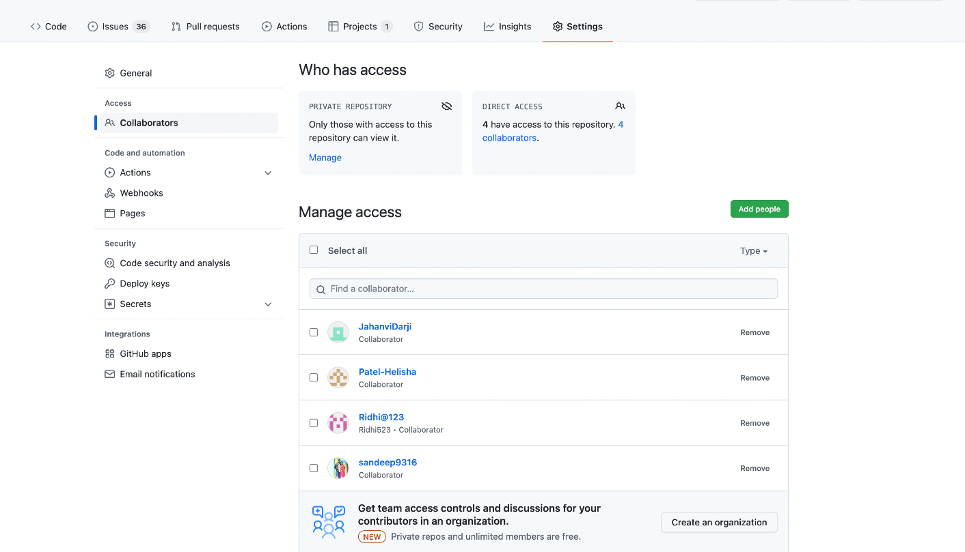
Team Standards –
Code and Document management
The given image demonstrates, that all the five group members of the project have created a project repository on the GitHub.

Slide 8
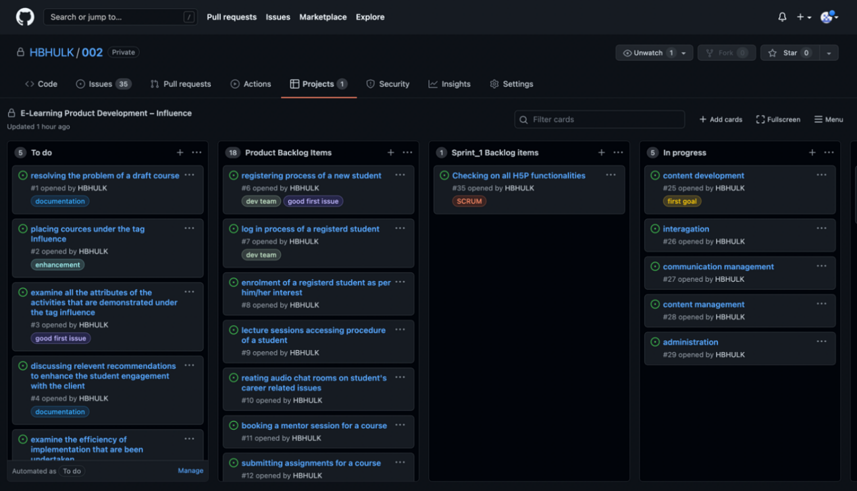
Team Standards –
Code and Document management
The given image describes that the project named E-Learning Product Development – Influence has been created on GitHub, with the to-do list, and product backlog.

Slide 9
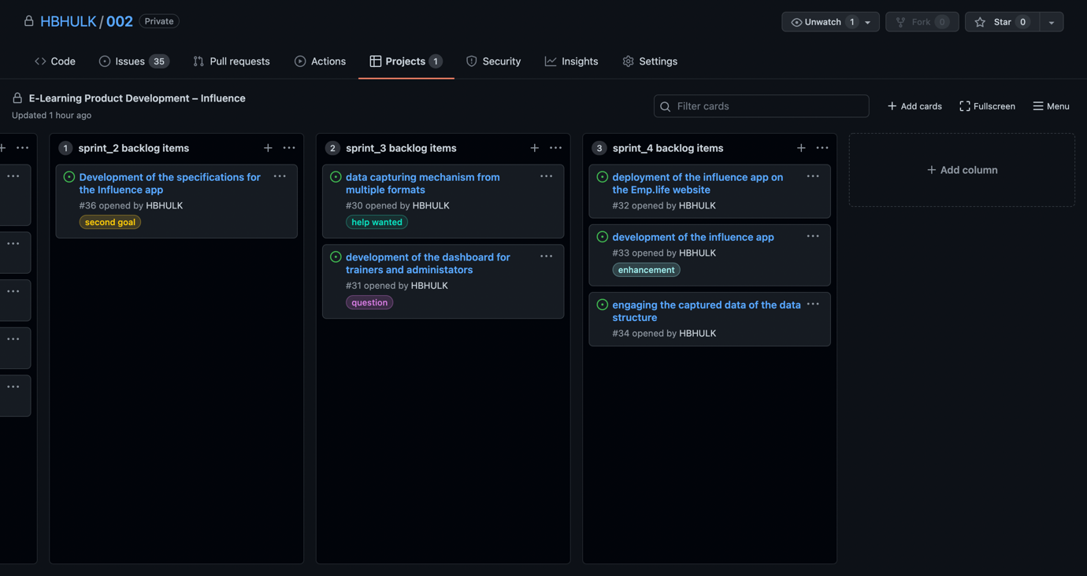
Team Standards –
Code and Document management
The image display shows all the other three sprints of the project, along with the specifications for the same.

Slide 10
Work Done: Reasonable justification for choice of product backlog items
1
Selection of product backlog items.
2
User types of the website.
3
Student engagement with the website.
4
Backlog items/ Condition of satisfaction/ Priority level
5
Client Feedback
Notes:
<a href='https://www.freepik.com/vectors/event'>Event vector created by stories - www.freepik.com</a>

Slide 11
Short Demo:
To provide design specifications, and suggestions.
The task of project designing is segregated into sub-tasks.
Comparison and contrast of design specifications.
Notes:
<a href='https://www.freepik.com/vectors/work'>Work vector created by stories - www.freepik.com</a>

Slide 12
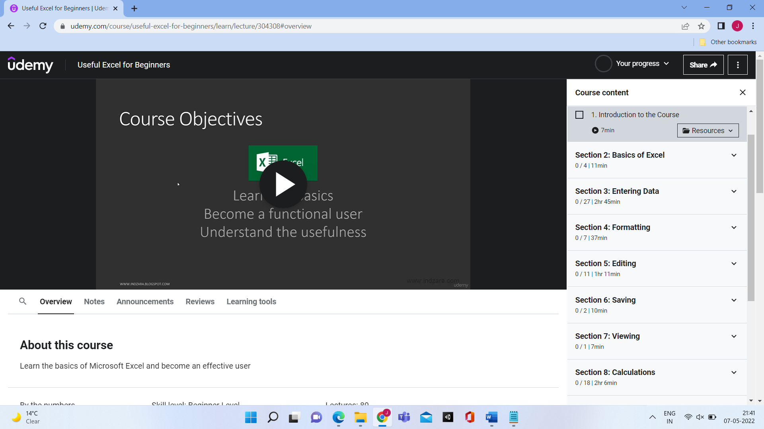
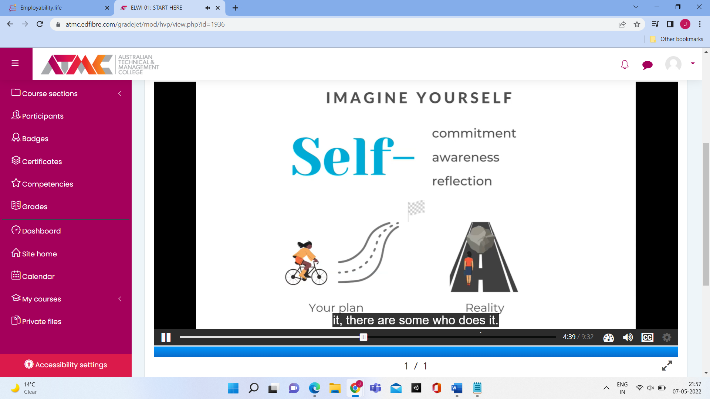
Demo (Design Specification):
1. Course Content
Udemy
Employability

Slide 13
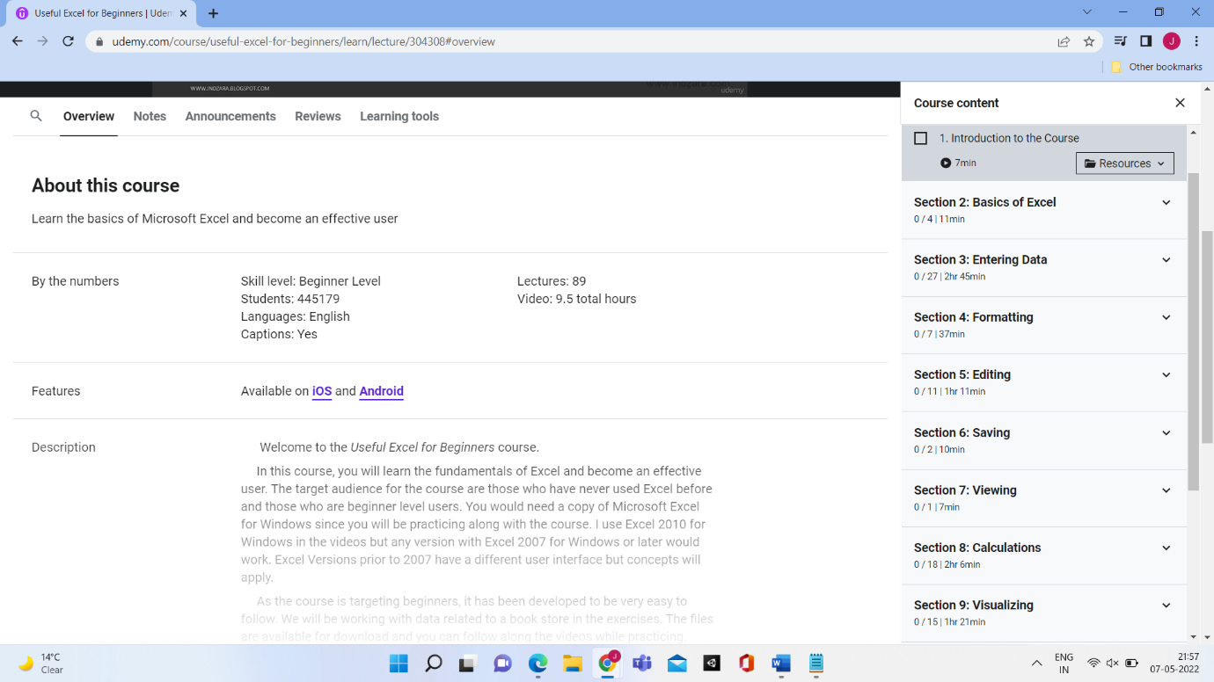
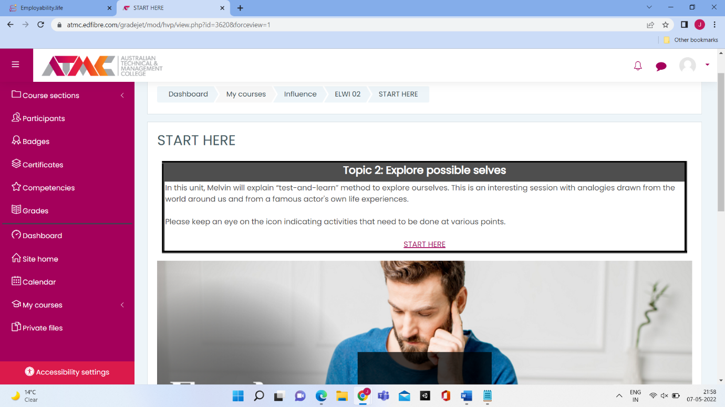
Demo (Design Specification):
2. Overview
Udemy
Employability

Slide 14
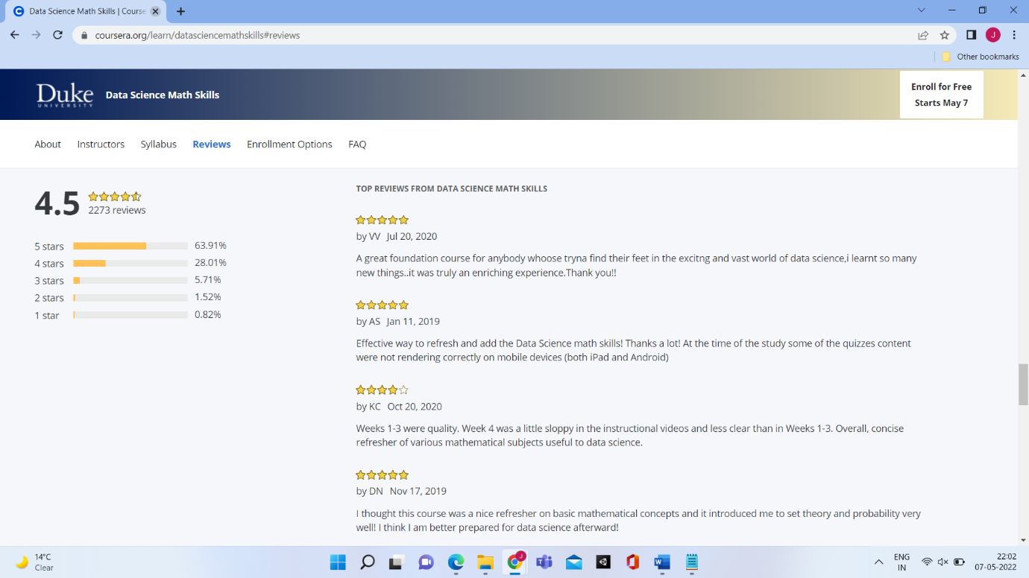
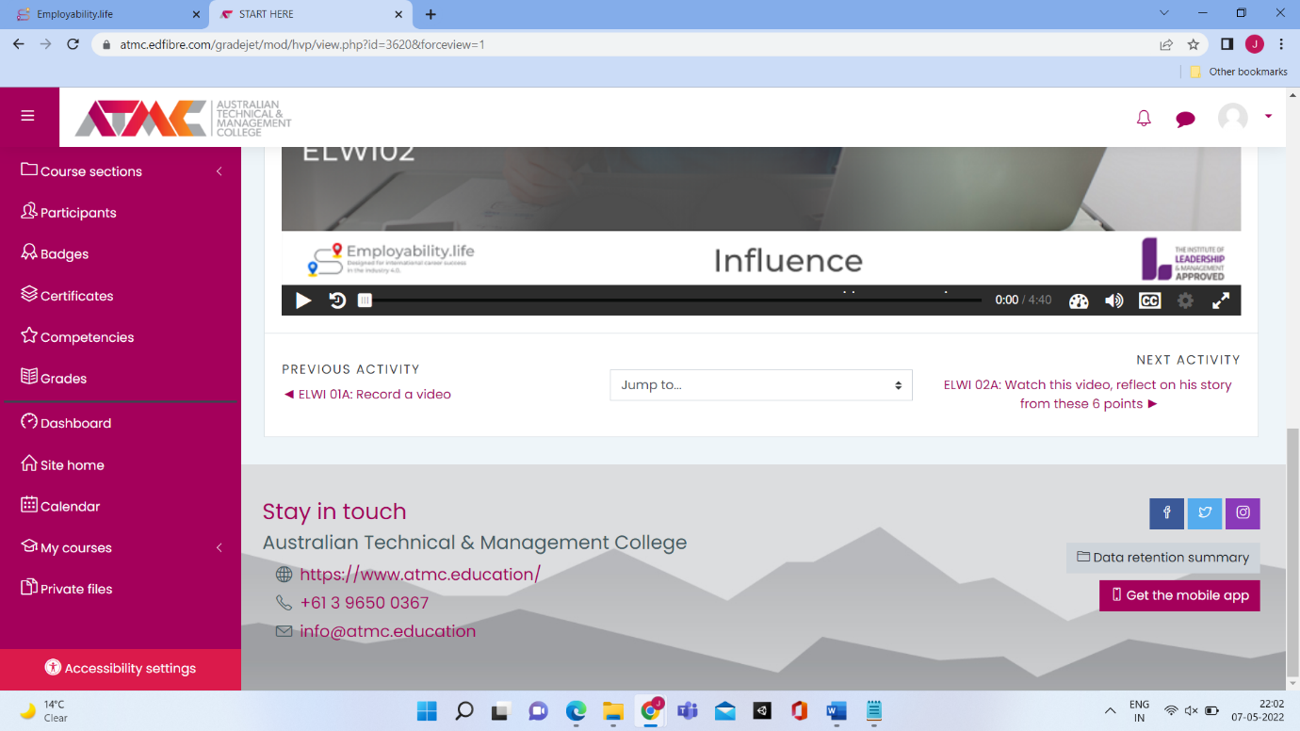
Demo (Design Specification):
3. Student Review
Coursera
Employability

Slide 15
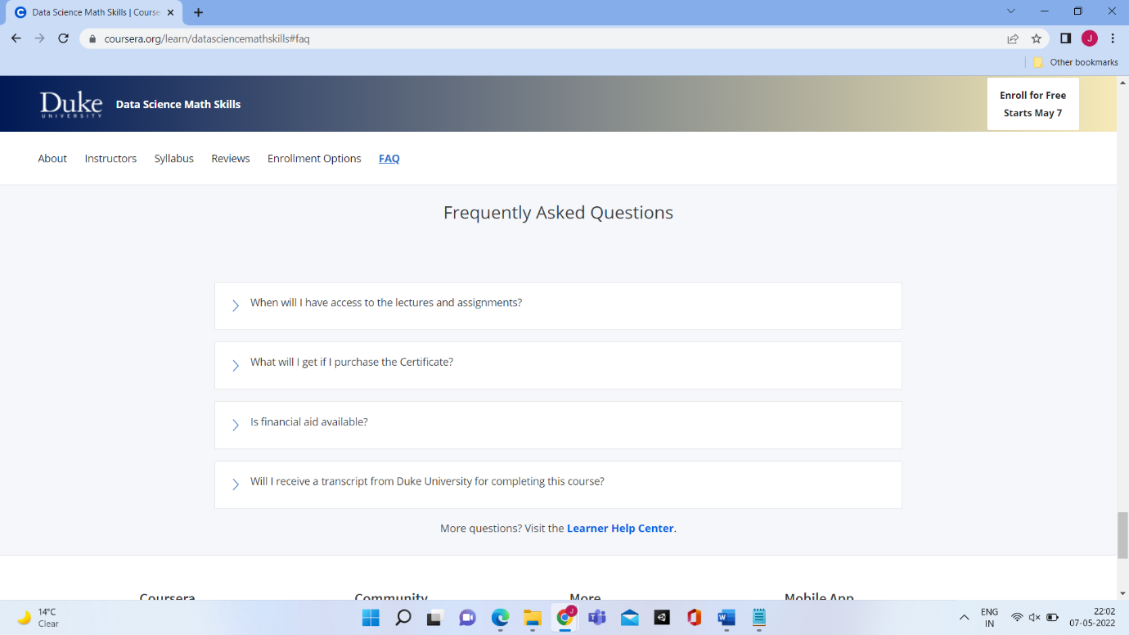
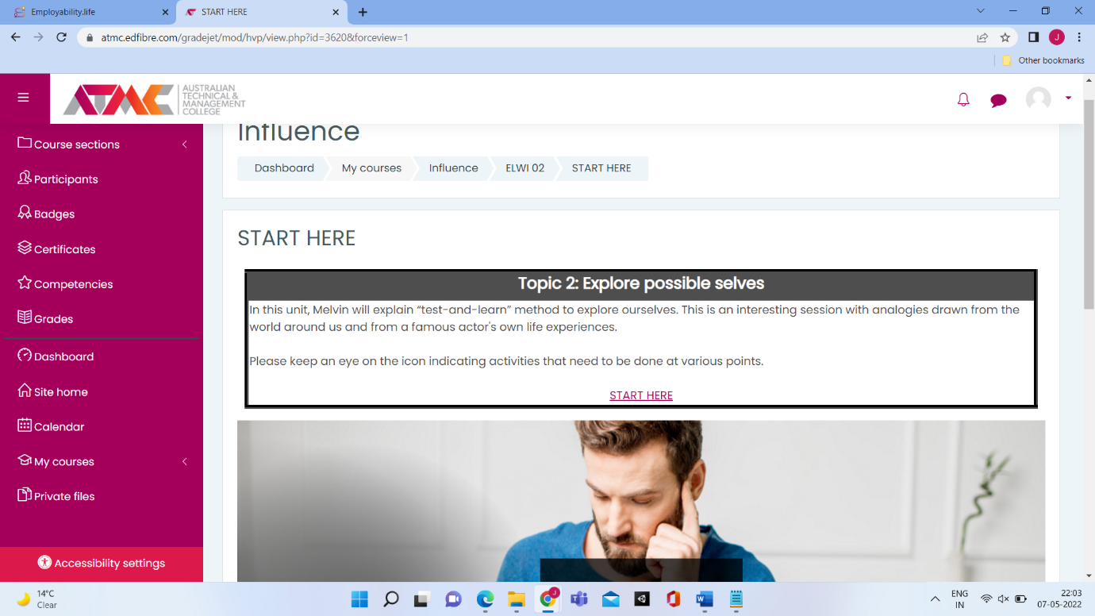
Demo (Design Specification):
4. FAQ
Coursera
Employability

Slide 16
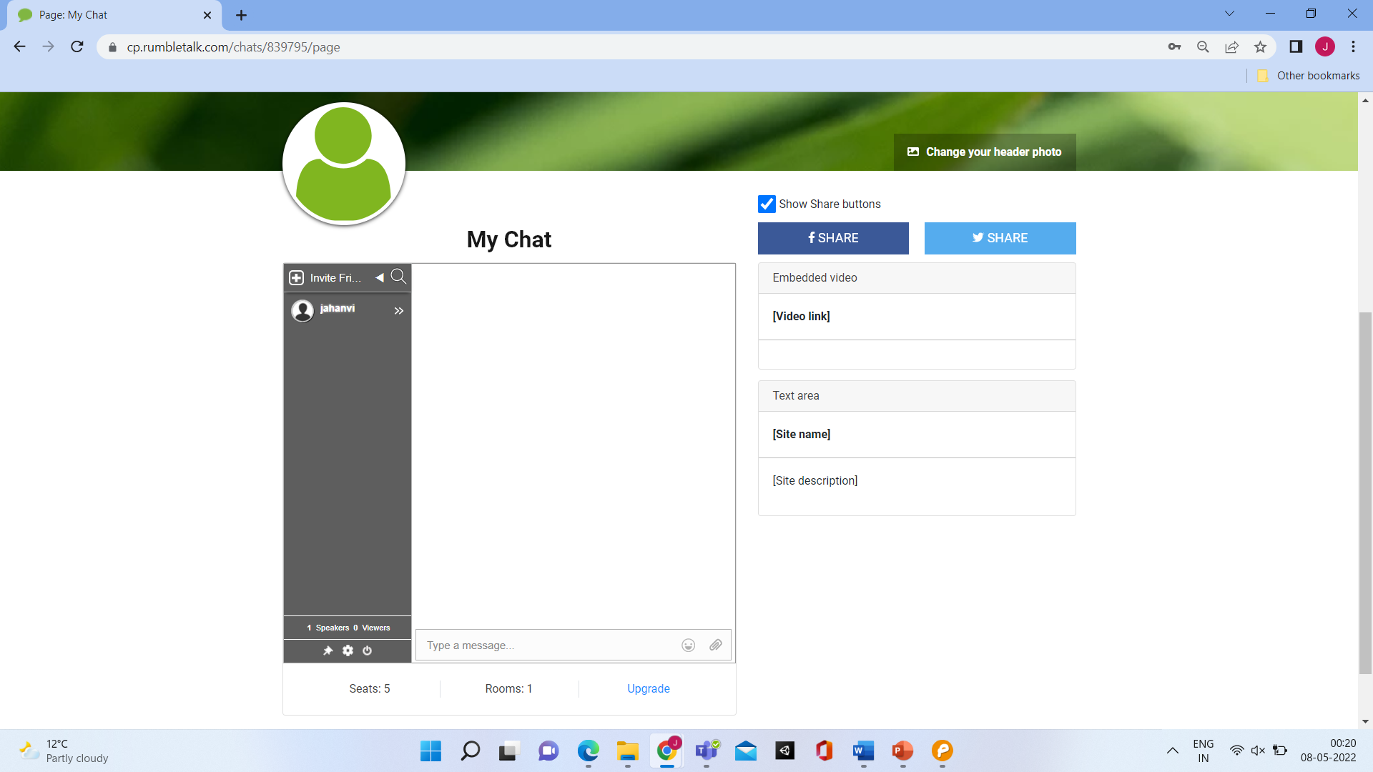
Demo (Design Specification):
5. Chat Rooms
RumbleTalk

Slide 17
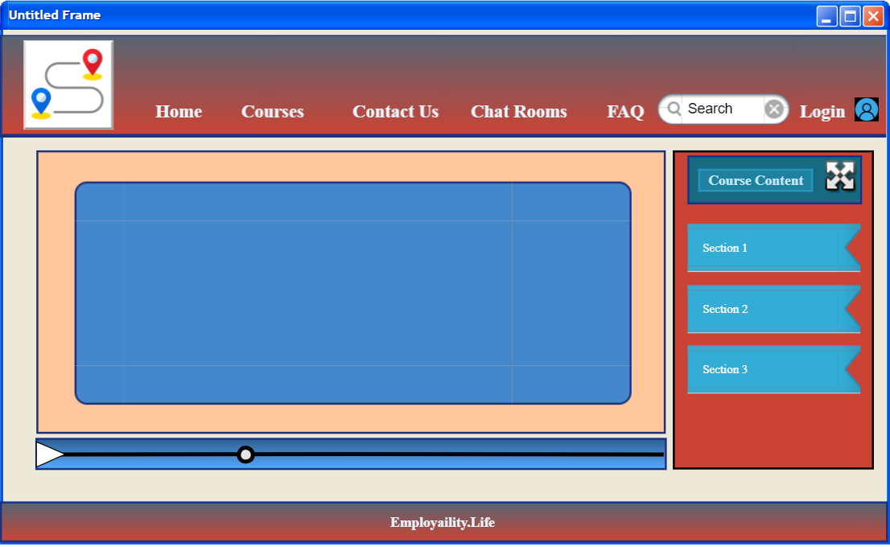
Wireframe:
1. Course Content

Slide 18
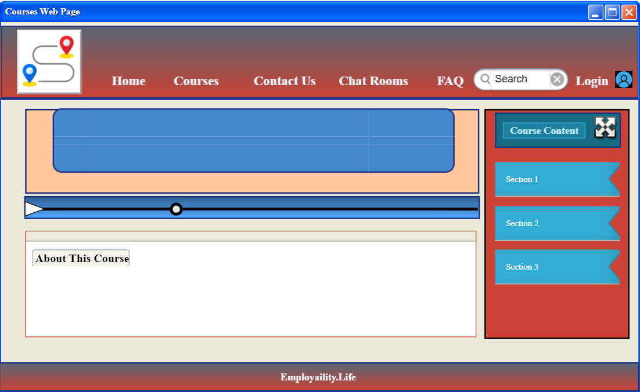
Wireframe:
2. Overview

Slide 19
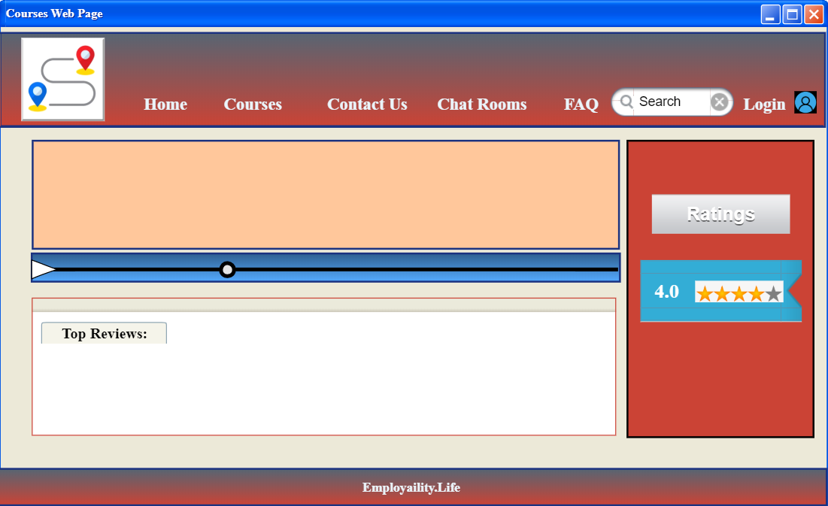
Wireframe:
3. Student Reviews

Slide 20
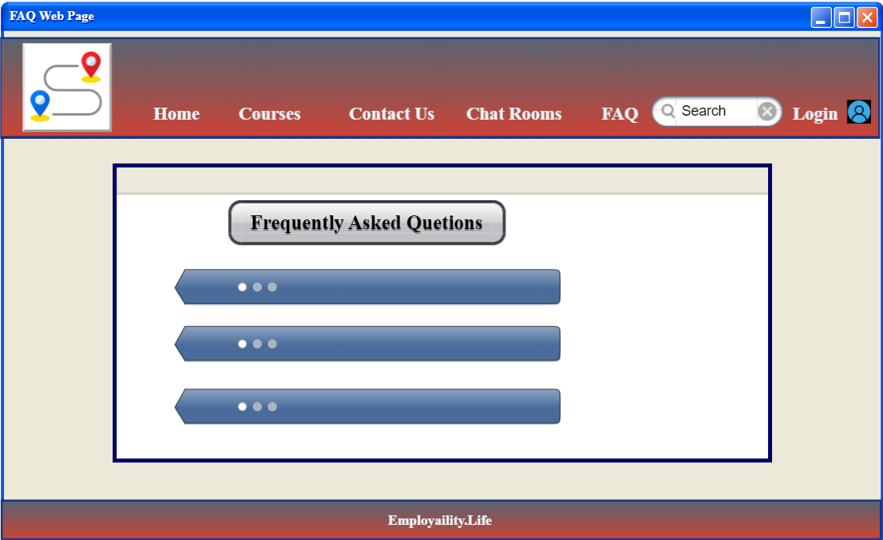
Wireframe:
4. FAQ

Slide 21
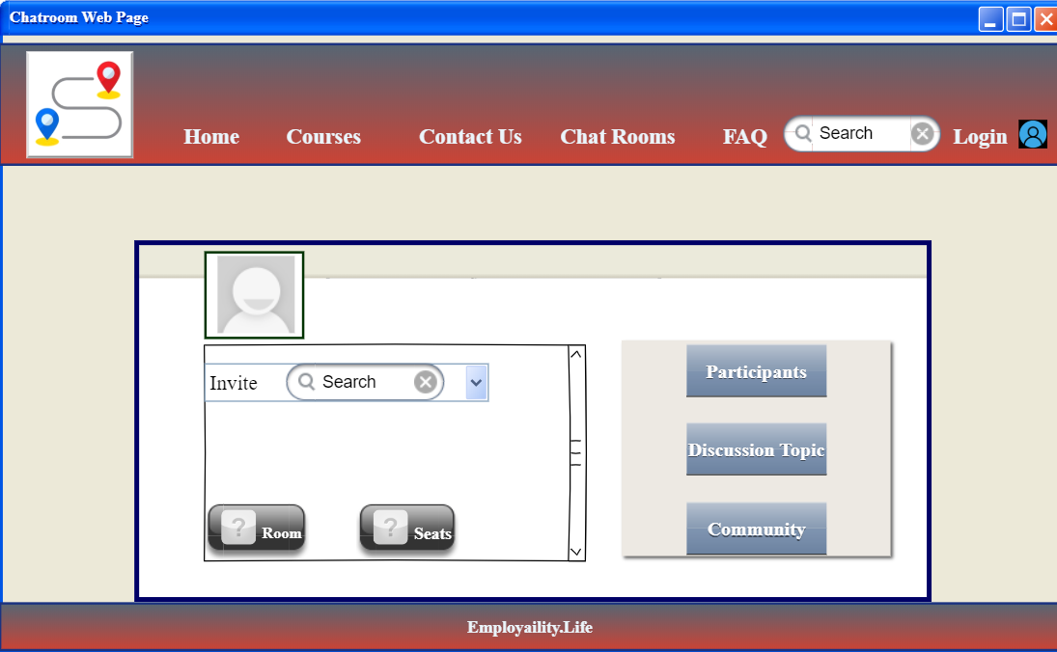
Wireframe:
5. Chat Rooms

Slide 22
Critical Reflection:
What went right!
What went wrong!
X
Open platform is facilitated by the product owner.
The time management issue
Actions taken:
Actions taken:
Measures undertaken for delivering quality work to the client
Execution of informal discussion meeting, among the team members

Slide 23
Thank You!
Notes:
Illustration : <a href="https://storyset.com/people">People illustrations by Storyset</a>
Photo : Photo by Albert Dera on Unsplash

